Slide 1

Cloud
Design Patterns

Slide 2

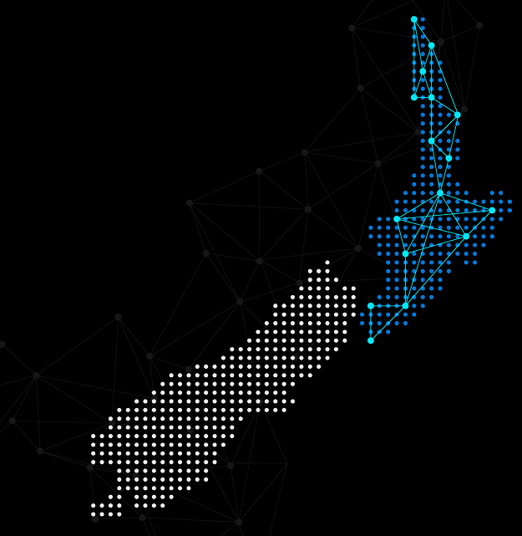

Hello!
Thank you for joining us today
Speaker: Luke Murray
Microsoft Learn Expert and Microsoft Azure MVP, and Senior Consultant from Hamilton, New Zealand.
https://x.com/lukemurraynz
https://www.linkedin.com/in/ljmurray/
https://luke.geek.nz/

Slide 3
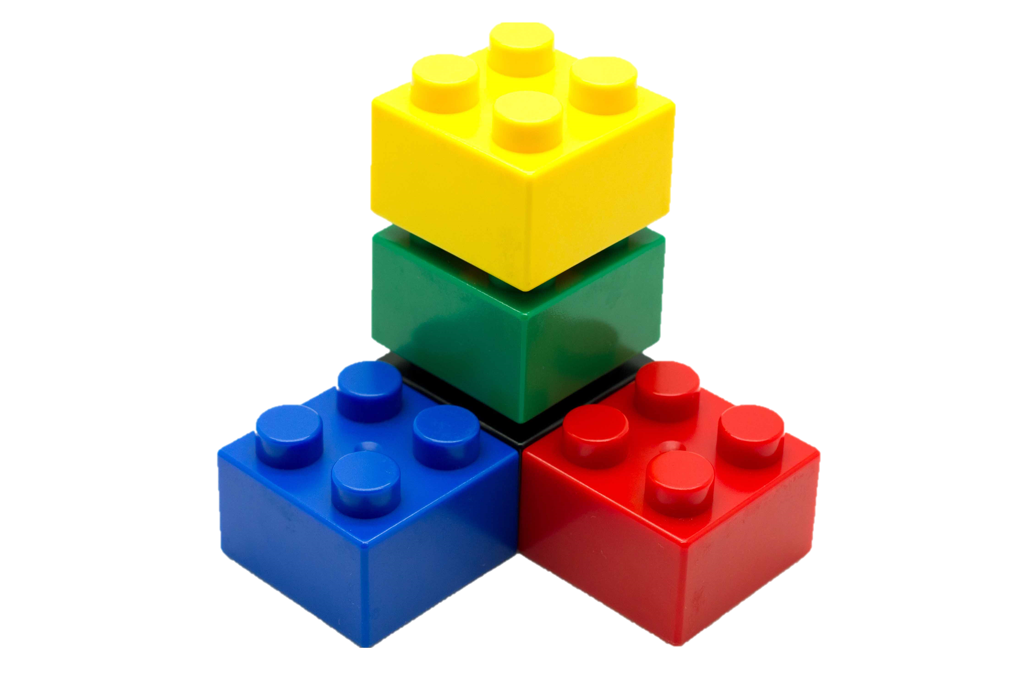
Importance of design patterns
Reusability of consistent patterns
Maintainability and administration of systems
DESIGN PATTERNS
Efficiency of avoiding repetitive work
Consistency and coherence in the deployment
Performance of optimizing resources
Modularity by promoting different building blocks

Slide 4
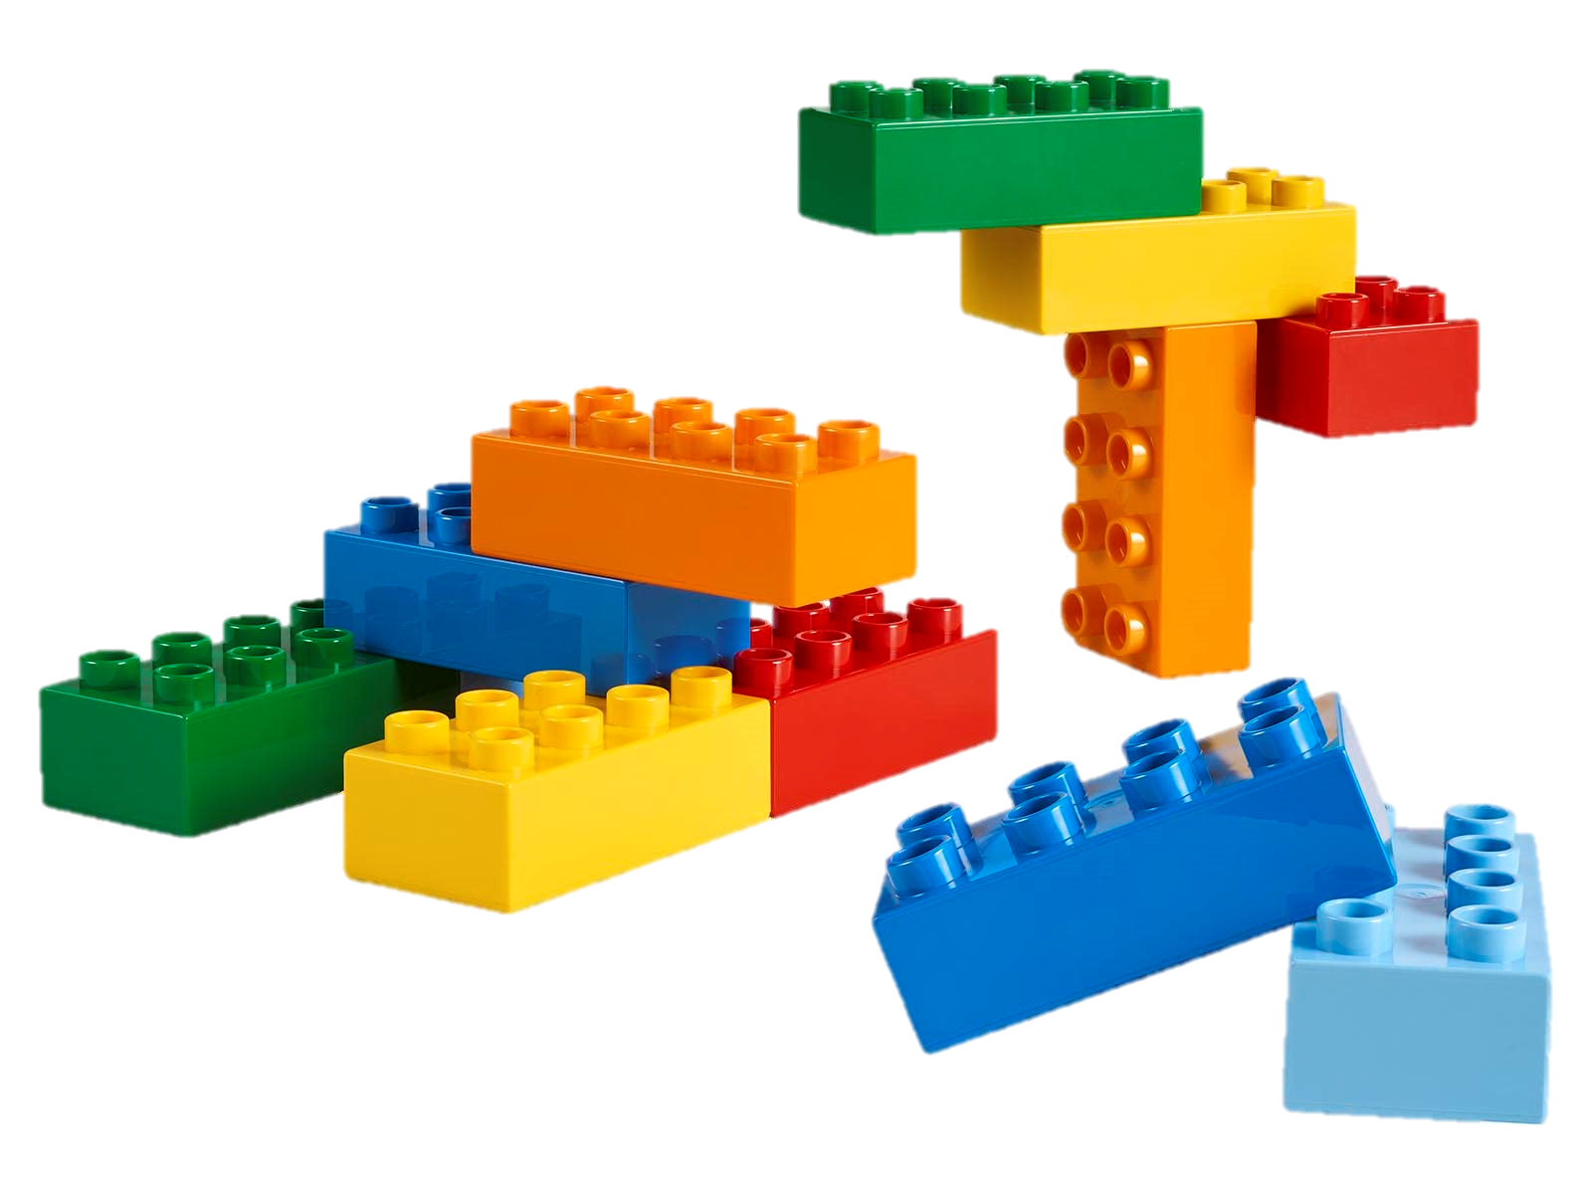
Importance in modern cloud architecture
Scalability
Operational excellence
CLOUD DESIGN PATTERNS
Resilience
Performance Efficiency
Security
Data Management

Slide 5
Acronyms
Acronym | Definition | Example
Service | A service in cloud pattern design refers to a distinct function or set of functions provided by a cloud application. Services are typically designed to be reusable and can be consumed by multiple clients or consumers. | In a microservices architecture, each microservice is a service that performs a specific business function, such as user authentication, payment processing, or data storage.
Consumer | A consumer is an entity (such as an application, service, or user) that consumes or uses the services provided by another service. Consumers send requests to services and receive responses. | A web application that calls an authentication service to verify user credentials is a consumer of that authentication service.
Tenant | In a multi-tenant architecture, a tenant is a group of users who share common access with specific privileges to the software instance. Each tenant's data is isolated and remains invisible to other tenants. | In a Software as a Service (SaaS) application, each customer (company or organization) is considered a tenant. They have their own isolated data and configuration settings within the shared application.

Slide 6
Categories of Patterns

Slide 7





Archetypes (Categories) of Patterns
Data Management
Design & Implementation
Messaging
Reliability
Security

Slide 8
Pattern Deep Dive

Slide 9
Data management
Cache-Aside
Load data on demand into a cache from a data store
Sharding
Divide a data store into a set of horizontal partitions or shards.
Valet Key
Use a token or key that provides clients with restricted direct access to a specific resource or service.
Static Content Hosting
Deploy static content to a cloud-based storage service that can deliver them directly to the client.

Slide 10
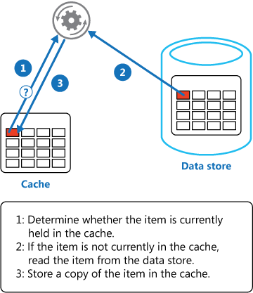
Cache Aside
Applications use a cache to improve repeated access to information held in a data store.
However, it's impractical to expect that cached data will always be completely consistent with the data in the data store

Slide 11
Cache Aside
Issues & Considerations
Lifetime of cached data
Priming the cache
Consistency
Local (in-memory) caching
Evicting data

Slide 12
Cache Aside
When to use this pattern
A cache doesn't provide native read-through and write-through operations.
Resource demand is unpredictable.
When the cached data set is NOT static
When NOT caching session state information in a web application hosted in a web farm.

Slide 13
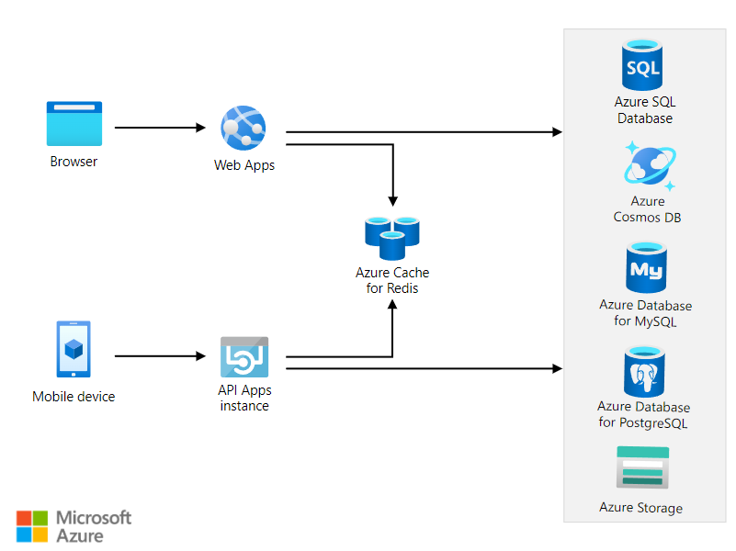

Cache Aside
Azure Solutions

Slide 14
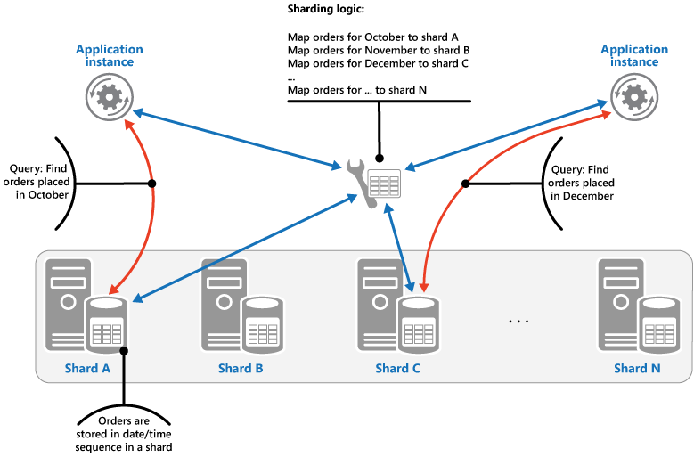
Sharding
A data store hosted by a single server might be subject to the following limitations:
Storage space
Computing resources.
Network bandwidth
Geography
Vertical scaling isn't necessarily the best solution.

Slide 15
Sharding
Issues & Considerations
Shard balancing
Using stable and unique keys data to determine sharding state
Efficient query design to query sharding data
Designing for scalability (storage nodes – data & throughput)
Monitoring, backup and maintaining consitancy of multiple shards

Slide 16
Sharding
When to use this pattern
Improve performance by reducing contention on a single data store.
Improve resilience and reliability.
Data store is likely to need to scale beyond the resources of a single storage node.
Geographical Optimization based on where users or systems are located.
Optimize cost by multiple instances of less expensive compute or storage.

Slide 17
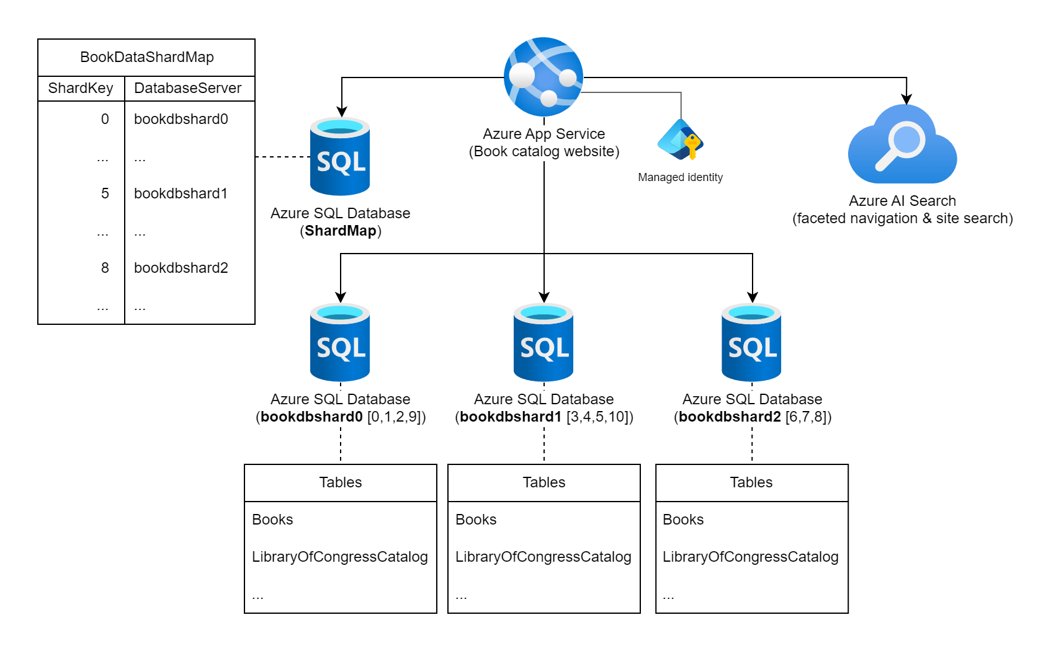


Sharding
Azure Solutions

Slide 18
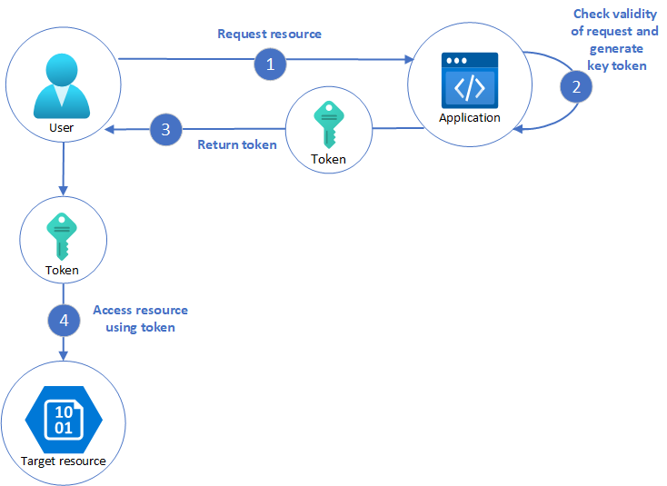
Valet Key
Client programs and web browsers often need to read and write files or data streams to and from an application's storage. Typically, the application will handle the movement of the data — either by fetching it from storage and streaming it to the client, or by reading the uploaded stream from the client and storing it in the data store.
However, this approach absorbs valuable resources such as compute, memory, and bandwidth.

Slide 19
Valet Key
Issues & Considerations
Ensure that the token or key used for access is securely generated and transmitted to prevent unauthorized access
Ensure that the resources are managed efficiently to avoid unnecessary costs, especially when dealing with frequent or large client requests
Implement mechanisms to easily revoke access, if necessary,
Cost savings from offloading processing must be weighed against the complexity of implementing and managing the Valet Key pattern
Could introduce security and audit risks if not implemented correctly

Slide 20
Valet Key
When to use this pattern
Offload data transfer from the application to minimize the use of valuable resources such as compute, memory, and bandwidth.
Clients regularly upload or download data, particularly where there's a large volume or when each operation involves large file
Minimize operational cost by enabling direct access to stores and queues .
When the data is stored in a remote data store or a different datacenter to the application.
If the application doesn’t need to perform tasks on the data first.

Slide 21
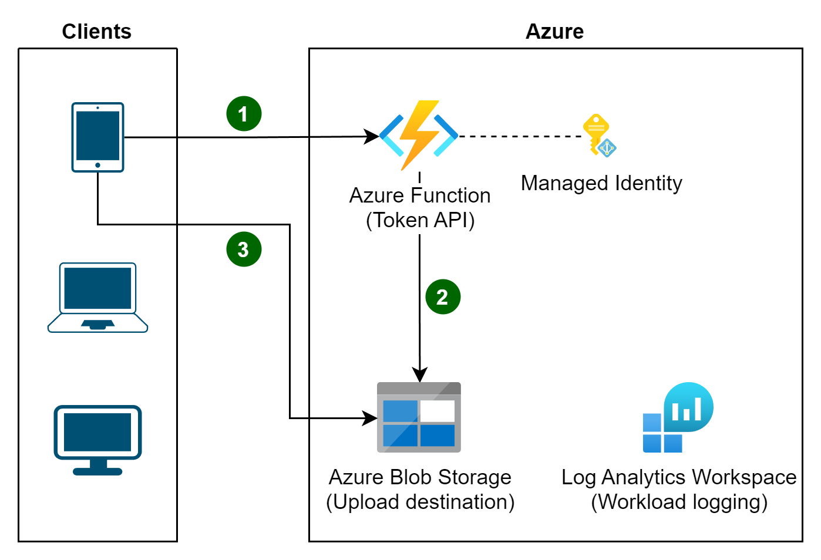

Valet Key
Azure Solutions

Slide 22
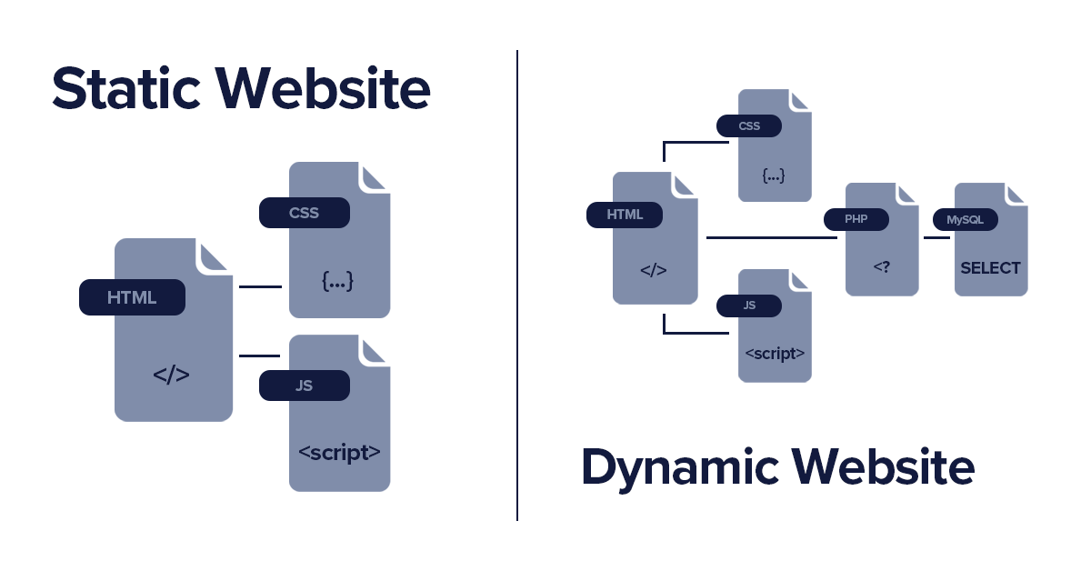
Static Content Hosting
Web applications typically include elements of static content. This content might include HTML and other resources such as images that are available to the client.
Although web servers are optimized for dynamic rendering and output caching, they still have to handle requests to download static content. This consumes processing cycles that could often be put to better use.

Slide 23
Static Content Hosting
Issues & Considerations
Static content may need to be provisioned and deployed independently from the application if it is not included in the application deployment package or process.
Geographic concerns, consider using a content delivery network (CDN) to cache the contents of the storage container in multiple datacenters around the world.
Security access, needs to be considered – i.e., Public write access to prevent unauthorized uploads.
Storage services might not support the use of custom domain name
File compression, such as gzip, to reduce load times for clients.
Consider how to handle local development and testing
Caching of existing assets.

Slide 24
Static Content Hosting
When to use this pattern
Improve the performance and availability of your application by using a content delivery network (CDN) to cache the contents of the storage container in multiple datacenters around the world.
Reduce the hosting costs for websites and applications that contain some static resources. Cloud-hosted storage is typically much less expensive than compute instances
Improve performance of your main WebApp by offloading static content serving
Expose static resources and content for applications running in other hosting environments or on-premises servers.

Slide 25
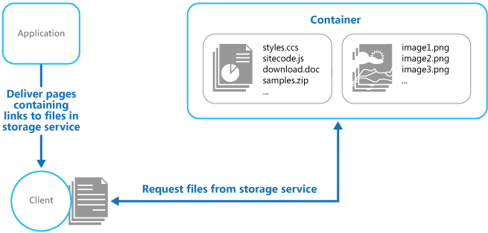


Static Content Hosting
Azure Solutions

Slide 26
Design
&
Implementation
Ambassador
Create helper services that send network requests on behalf of a consumer service or application.
Sidecar
Deploy components of an application into a separate process or container to provide isolation and encapsulation.
Leader Election
Coordinate the actions performed by a collection of collaborating task instances in a distributed application by electing one instance as the leader that assumes responsibility for managing the other instances.
Strangler Fig
Incrementally migrate a legacy system by gradually replacing specific pieces of functionality with new applications and services.

Slide 27
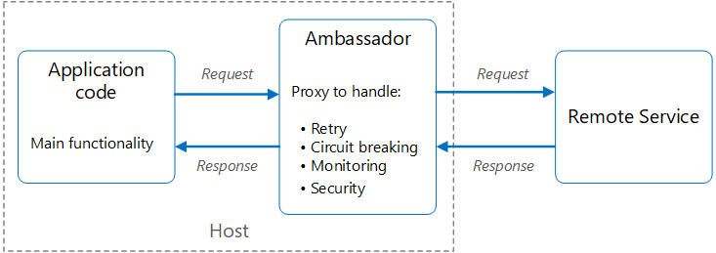
Ambassador
Resilient cloud-based applications require features such as circuit breaking, routing, metering and monitoring, and the ability to make network-related configuration updates. It may be difficult or impossible to update legacy applications or existing code libraries to add these features, because the code is no longer maintained or can't be easily modified by the development team.

Slide 28
Ambassador
Issues & Considerations
The proxy adds some latency overhead. It is important to evaluate whether a client library, invoked directly by the application, might be a better approach to avoid this additional latency
Consider a mechanism to allow the client to pass some context to the proxy and back to the client. For example, include HTTP request headers to opt out of retry or specify the maximum number of times to retry.
Generalized features in the proxy can have unintended consequences. For example, the ambassador could handle retries, but this might not be safe unless all operations are idempotent.
Consider how the Ambassador proxy is packaged and deployed (i.e., Sidecar), is it shared or dedicated.
Support and observability of the proxy component.

Slide 29
Ambassador
When to use this pattern
When you need to offload common client connectivity tasks such as monitoring, logging, routing, security (such as TLS), and resiliency patterns in a language-agnostic way
When dealing with legacy applications or other applications that are difficult to modify, the Ambassador pattern can extend their capabilities without requiring changes to the application code
When you want to enable a specialized team to implement and maintain security, networking, or authentication features independently of the application.
Support cloud or cluster connectivity requirements in a legacy application or an application that is difficult to modify

Slide 30
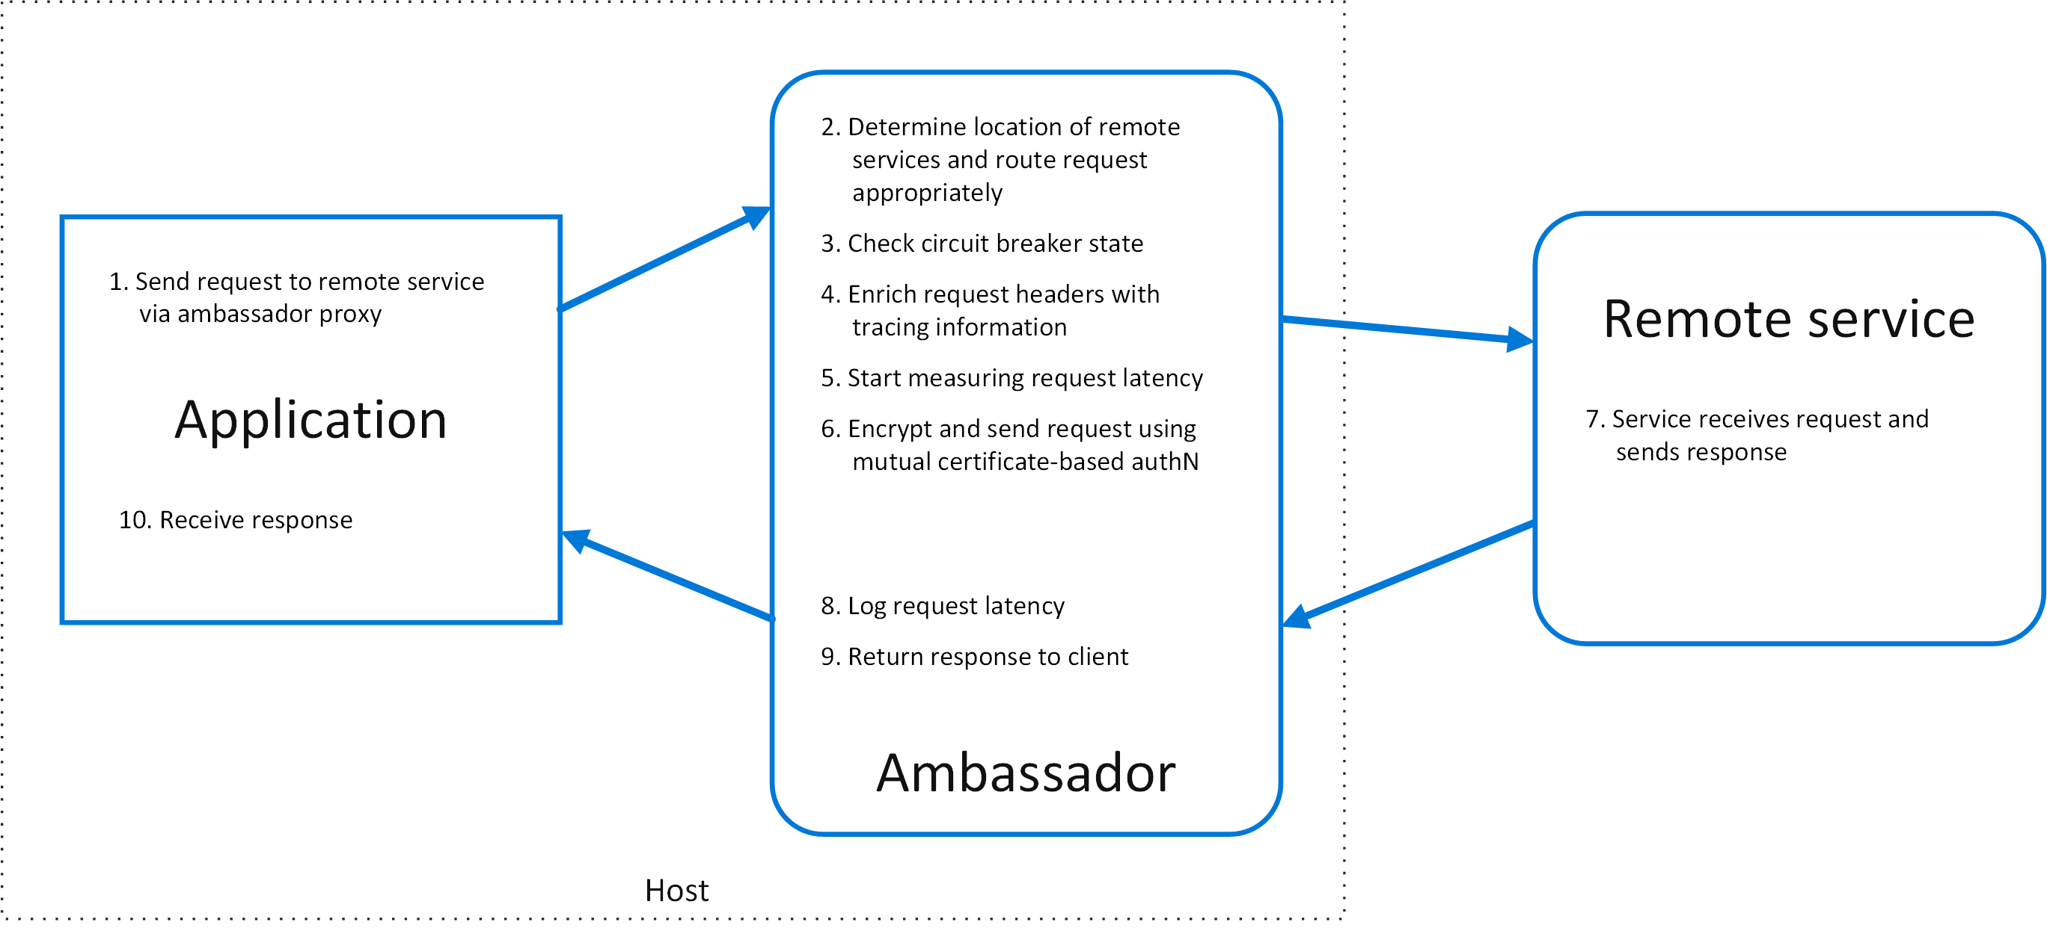



Ambassador
Azure Solutions

Slide 31
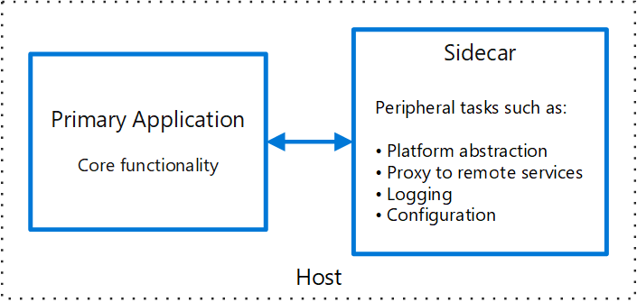
Sidecar
Deploy components of an application into a separate process or container to provide isolation and encapsulation. This pattern can also enable applications to be composed of heterogeneous components and technologies.
In the pattern, the sidecar is attached to a parent application and provides supporting features for the application.

Slide 32
Sidecar
Issues & Considerations
The resource cost of deploying a sidecar service for each instance may not be worth the advantage of isolation
Consider deployment and packaging format for services, processes, or containers. Containers are particularly well-suited to the sidecar pattern
If the service needs to scale differently or independently from the main applications, it may be better to deploy the feature as a separate service.
Consider whether it would work better as a separate service or a more traditional daemon
Moving cross-cutting tasks to a single process that can scale across multiple instances of the main process reduces the need to deploy duplicate functionality for each instance of the application

Slide 33
Sidecar
When to use this pattern
When your primary application uses a heterogeneous set of languages and frameworks. A component located in a sidecar service can be consumed by applications written in different languages using different frameworks
When you need a service that shares the overall lifecycle of your main application but can be independently updated.
When you want to move cross-cutting tasks to a single process that can scale across multiple instances of the main process, reducing the need to deploy duplicate functionality for each instance of the application
When you need to encapsulate tasks and deploy them out-of-process to reduce the surface area of sensitive processes to only the code needed to accomplish the task.

Slide 34

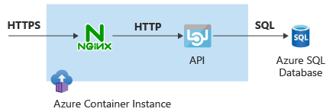
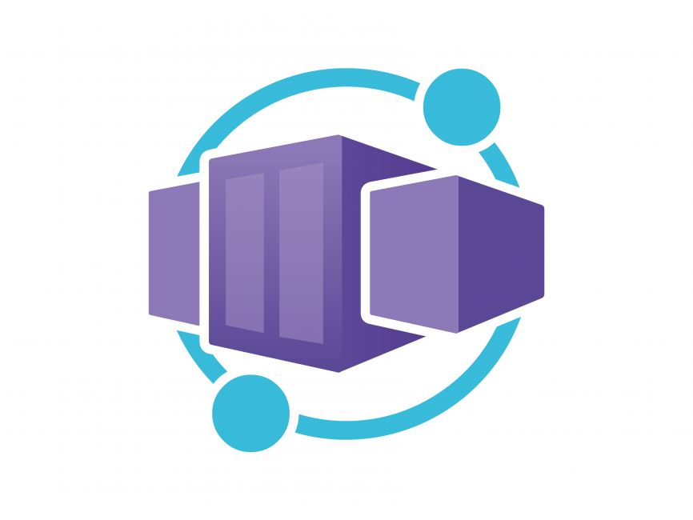
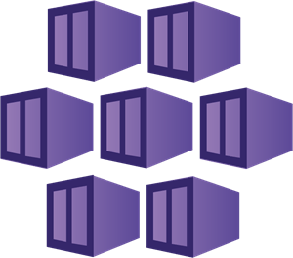
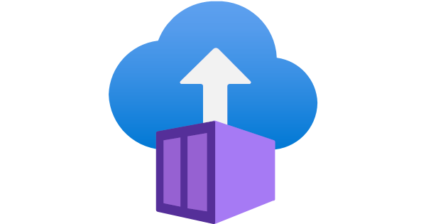
Sidecar
Azure Solutions

Slide 35
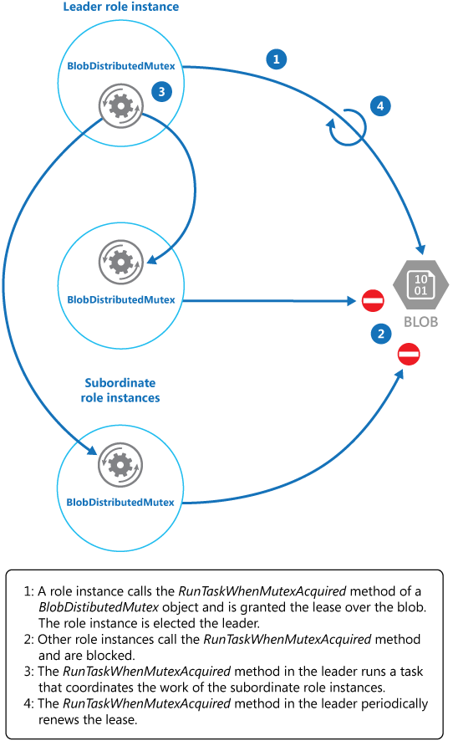
Leader Election
Coordinate the actions performed by a collection of collaborating instances in a distributed application by electing one instance as the leader that assumes responsibility for managing the others.
This can help to ensure that instances don't conflict with each other, cause contention for shared resources, or inadvertently interfere with the work that other instances are performing.

Slide 36
Leader Election
Issues & Considerations
Ensure the election process is managed carefully to prevent two or more instances from taking over the leader position simultaneously.
Avoid making the leader a bottleneck in the system. The leader's role is to coordinate the work of subordinate tasks, not necessarily to participate in the work itself. Ensure the leader can delegate tasks effectively to avoid performance issues
The system must be able to detect when the leader has failed or become unavailable (e.g., due to a communications failure, or scale up operation). The speed of detection depends on the system's requirements. Some systems can tolerate a short period without a leader, while others need immediate detection and a new election

Slide 37
Leader Election
When to use this pattern
When you need to coordinate a task among multiple instances of a service or application. The Leader Election pattern ensures that one instance acts as the coordinator, preventing conflicts and ensuring smooth operation
When your application requires high availability and resilience. The pattern helps in maintaining service continuity by electing a new leader if the current one fails.
Manage failover and ensure that work is reliably redirected in case of node malfunctions. This is particularly useful in scenarios where reliability and self-healing are critical

Slide 38
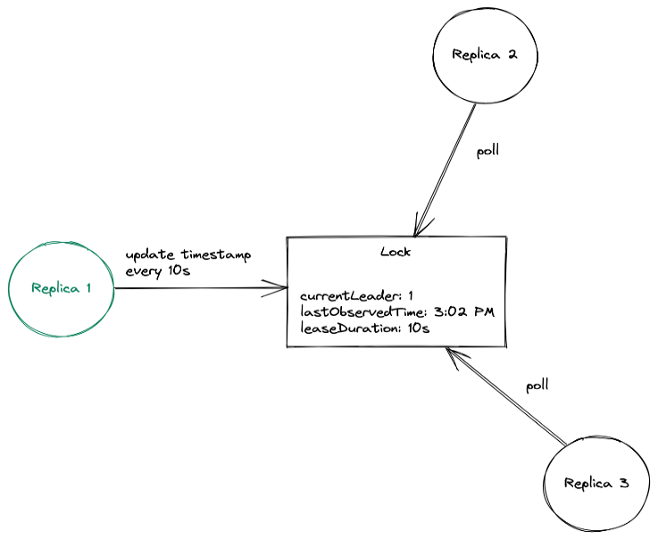


Leader Election
Azure Solutions

Slide 39
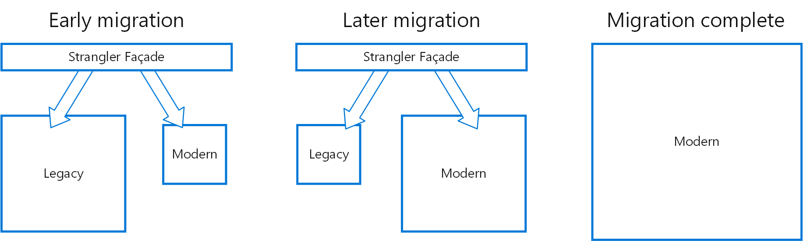
Strangler Fig
Incrementally migrate a legacy system by gradually replacing specific pieces of functionality with new applications and services.
As features from the legacy system are replaced, the new system eventually replaces all of the old system's features, strangling the old system and allowing you to decommission it.

Slide 40
Strangler Fig
Issues & Considerations
Ensure that both new and legacy systems can access shared services and data stores. This is crucial for maintaining consistency and avoiding data integrity issues during the migration process
The pattern supports incremental migration, which helps to minimize risk and spread the development effort over time. However, this requires careful planning to ensure that each increment is functional and does not disrupt the overall system
The facade, which intercepts requests and routes them to either the legacy or new system, must keep up with the migration. It should not become a single point of failure or a performance bottleneck.
Ensure that the facade does not become a single point of failure. It should be designed to handle high availability and failover scenarios to maintain system reliability during the migration
Complete migration and modernization

Slide 41
Strangler Fig
When to use this pattern
When you need to incrementally migrate a legacy system to a new architecture. This pattern allows you to gradually replace specific pieces of functionality with new applications and services, minimizing risk and spreading the development effort over time
When it is essential to keep the legacy system operational during the migration.
The Strangler Fig pattern enables a controlled decomposition of a monolith into a set of microservices, allowing the legacy system to continue functioning while new features are added to the new system

Slide 42
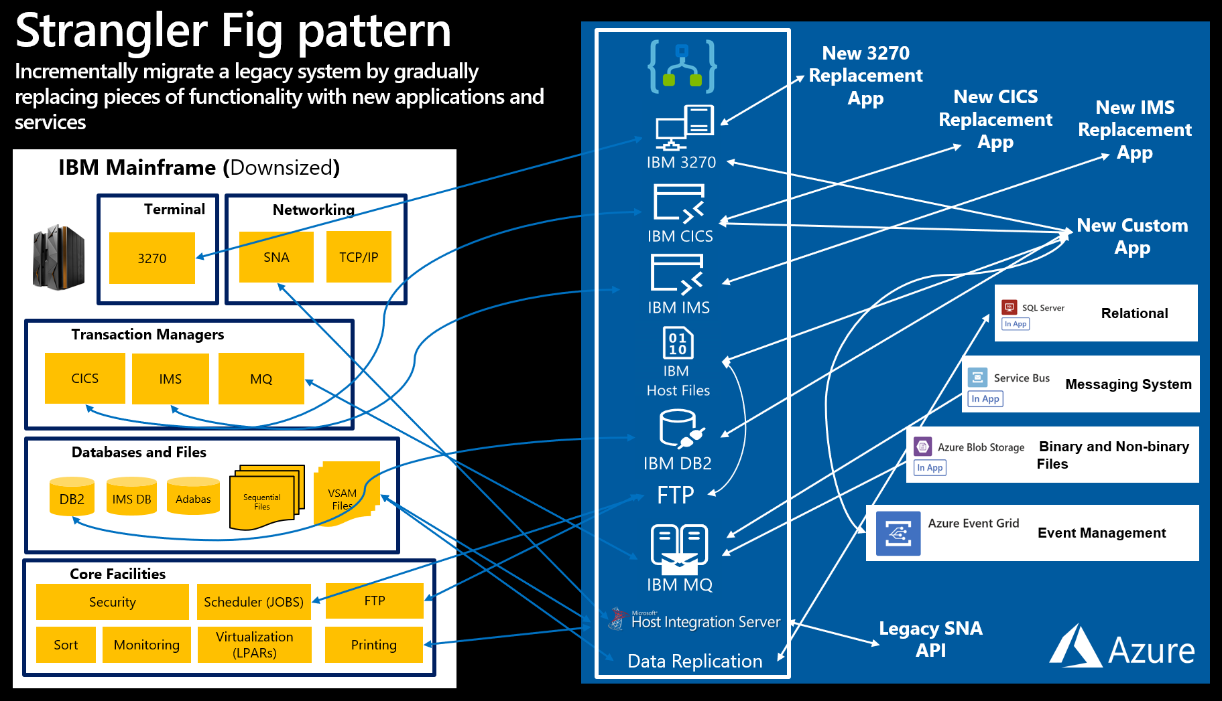

Strangler Fig
Azure Solutions

Slide 43
Messaging
Sequential Convoy
Process a set of related messages in a defined order, without blocking processing of other groups of messages.
Queue-Based Load Leveling
Use a queue that acts as a buffer between a task and a service that it invokes in order to smooth intermittent heavy loads.
Publisher-Subscriber
Enable an application to announce events to multiple interested consumers asynchronously, without coupling the senders to the receivers.
Asynchronous Request-Reply
Decouple backend processing from a frontend host, where backend processing needs to be asynchronous, but the frontend still needs a clear response.

Slide 44
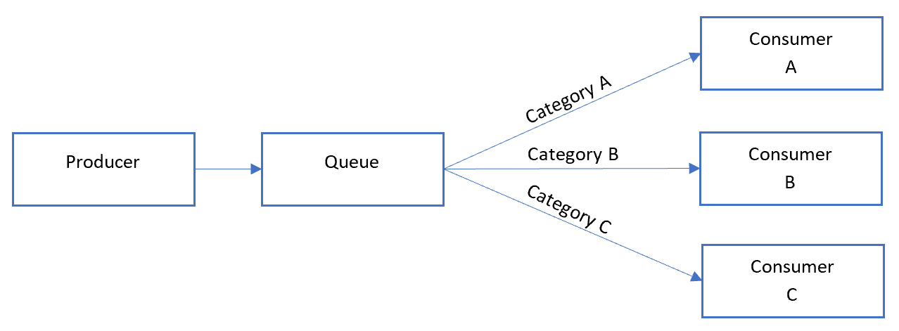
Sequential Convoy
Applications often need to process a sequence of messages in the order they arrive, while still being able to scale out to handle increased load.
Process a set of related messages in a defined order, without blocking processing of other groups of messages.

Slide 45
Sequential Convoy
Issues & Considerations
Ensuring that messages are processed in the order they arrive can be challenging in a distributed architecture. Workers can scale independently and often pull messages independently, which can disrupt the order of processing
Requires careful management to ensure that the order of messages is maintained. This can involve categorizing related messages within the queuing system and having queue listeners lock and pull only from one category at a time
Sequential Convoy pattern can be complex, especially when dealing with interleaved transactions for multiple orders.
If an error occurs, the system must ensure that subsequent messages are not processed until the error is resolved,

Slide 46
Sequential Convoy
When to use this pattern
When you have messages that arrive in a specific order and must be processed in that same order. This is crucial for maintaining the integrity and consistency of the operations being performed.
When you need to process a set of related messages in a defined order without blocking the processing of other groups of messages.
When arriving messages can be categorized in such a way that the category becomes a unit of scale for the system.

Slide 47
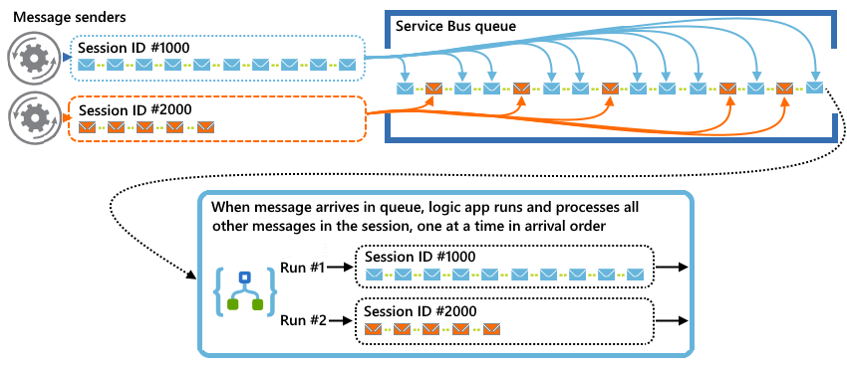


Sequential Convoy
Azure Solutions

Slide 48
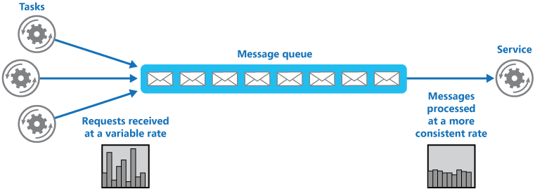
Queue-Based Load Levelling
Use a queue that acts as a buffer between a task and a service it invokes in order to smooth intermittent heavy loads that can cause the service to fail or the task to time out.
This can help to minimize the impact of peaks in demand on availability and responsiveness for both the task and the service.
The queue decouples the tasks from the service

Slide 49
Queue-Based Load Levelling
Issues & Considerations
Requires careful management to ensure that the order of messages is maintained. This can involve categorizing related messages within the queuing system and having queue listeners lock and pull only from one category at a time
Adjustments may be needed in the number of queues and the number of service instances that handle messages to achieve optimal performance
It is necessary to implement application logic that controls the rate at which services handle messages to avoid overwhelming the target resource.
Careful management is required to ensure that the system scales effectively without introducing bottlenecks

Slide 50
Queue-Based Load Levelling
When to use this pattern
When a service is subjected to intermittent heavy loads that can cause performance or reliability issues.
When you want to ensure that delays in services do not have an immediate and direct impact on the application.
When you need to perform tasks asynchronously to maintain the responsiveness of the user interface and distribute processing across multiple servers to improve throughput
When you need to decouple tasks from services to allow the service to handle messages at its own pace, regardless of the volume of requests from concurrent tasks.

Slide 51
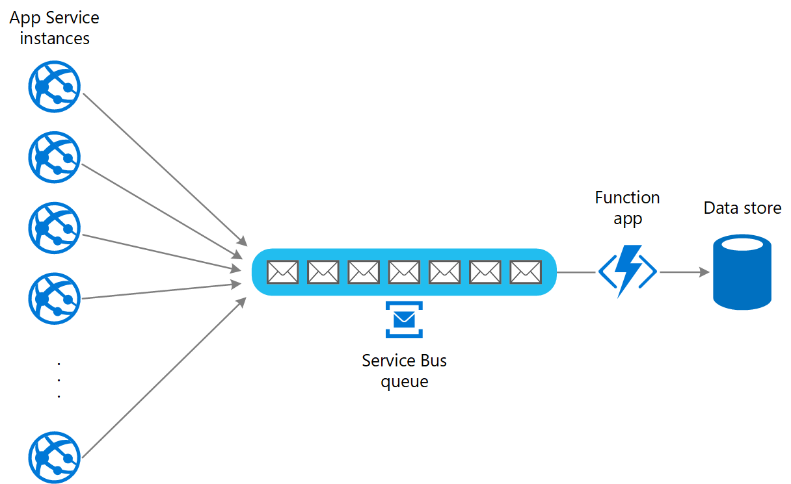
Queue-Based Load Levelling
Azure Solutions

Slide 52
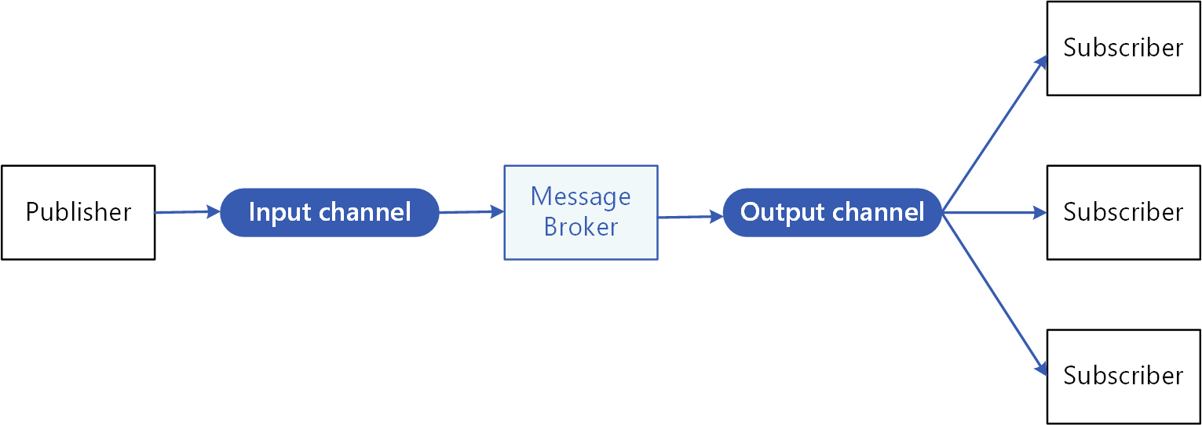
Publisher-Subscriber
Enable an application to announce events to multiple interested consumers asynchronously, without coupling the senders to the receivers.

Slide 53
Publisher-Subscriber
Issues & Considerations
One of the main challenges is ensuring the system can scale efficiently as the number of subscribers increases. Each new subscriber typically requires additional resources and potentially changes to the application code to handle the new message queue
Ensuring that messages are delivered to all subscribers reliably and in a timely manner can be complex. Message queues generally aim to deliver messages in a first-in-first-out (FIFO) manner, but this order is not always guaranteed, especially under high load conditions
Implementing effective monitoring and alerting mechanisms is crucial to track the performance of message queues, detect stuck messages, and ensure that subscribers are processing messages efficiently
he Pub-Sub pattern is inherently one-way, meaning that subscribers cannot send acknowledgments or responses back to the publisher. If two-way communication is needed, another pattern like Request-Reply should be implemented

Slide 54
Publisher-Subscriber
When to use this pattern
When you need to send the same information to multiple consumers simultaneously, this allows a single publisher to broadcast messages to multiple subscribers without needing to send individual messages to each one.
When you need to enable asynchronous communication between different parts of a system. This allows the publisher to send messages without waiting for the subscribers to process them
When you want to decouple the senders of messages from the receivers, enabling them to operate independently. This is useful in systems where the publisher does not need to know about the subscribers and vice versa
Event driven architectures

Slide 55
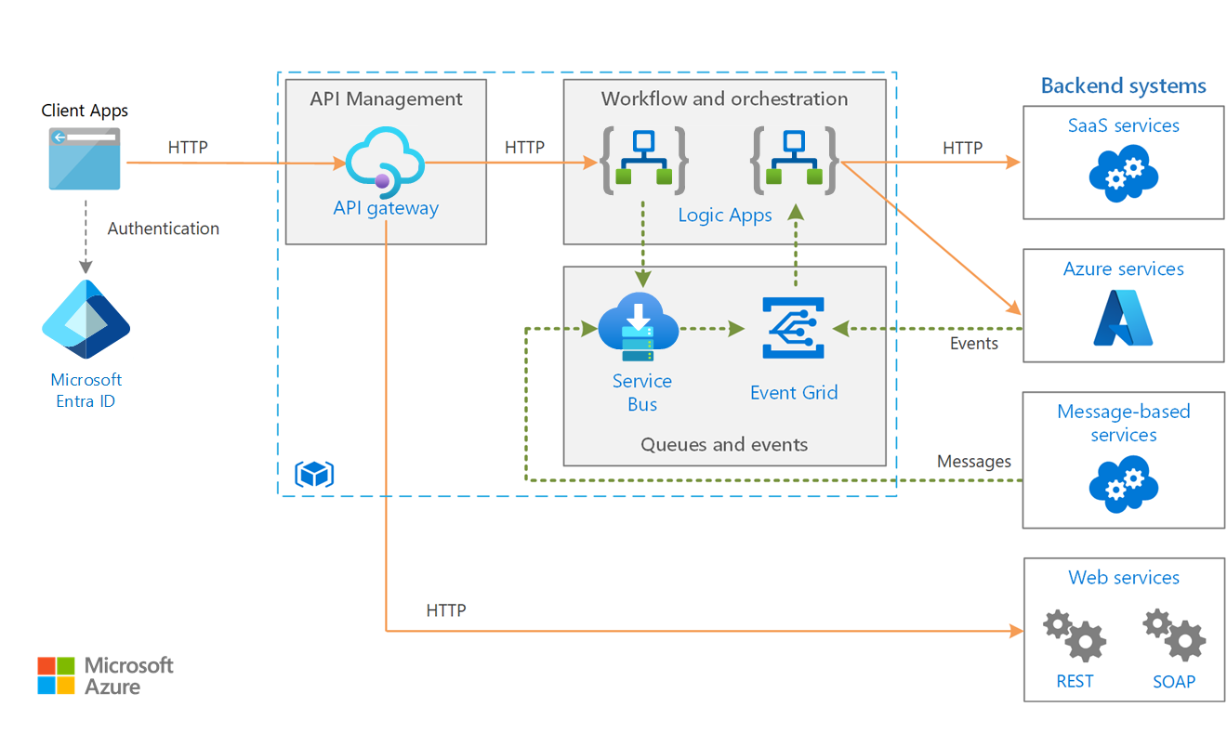

Publisher-Subscriber
Azure Solutions

Slide 56
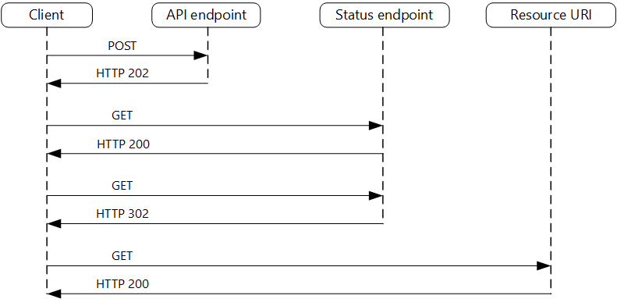
Asynchronous Request-Reply
Decouple backend processing from a frontend host, where backend processing needs to be asynchronous, but the frontend still needs a clear response.

Slide 57
Asynchronous Request-Reply
Issues & Considerations
The pattern is designed to handle scenarios where backend processing is long-running. However, this introduces latency in the response time
The backend must be capable of handling long-running operations efficiently.
Implementing an efficient polling and error handling mechanism is crucial. The HTTP 202 response should indicate the location and frequency that the client should poll for the response. This helps in managing the load on the server and ensures that the client does not overwhelm the server with frequent polling requests
The client-side code must be designed to handle asynchronous responses.
Ensuring secure communication between the client and the server is essential.

Slide 58
Asynchronous Request-Reply
When to use this pattern
When the backend processing is long-running, taking seconds, minutes, or even hours, and it is not feasible to keep the client waiting for the operation to complete. This pattern allows the client to initiate the request and then poll for the result later.
Enables the client process and the backend API to scale independently.
Decouple the frontend host from the backend processing. This is useful in scenarios where the frontend needs a clear response, but the backend processing needs to be asynchronous
Implementing microservices architectures where server-to-server REST API calls are common.

Slide 59
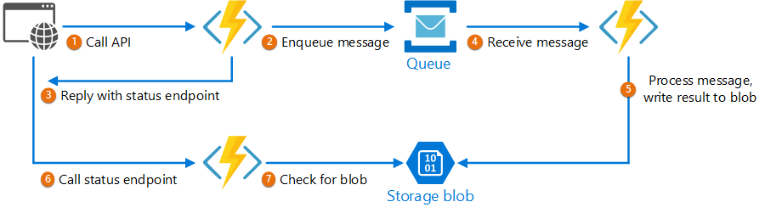
Asynchronous Request-Reply
Azure Solutions

Slide 60
Reliability
Circuit Breaker
Handle faults that might take a variable amount of time to recover from, when connecting to a remote service or resource. This can improve the stability and resiliency of an application.
Deployment Stamps
The deployment stamp pattern involves provisioning, managing, and monitoring a heterogeneous group of resources to host and operate multiple workloads or tenants.
Bulkhead
In a bulkhead architecture, elements of an application are isolated into pools so that if one fails, the others will continue to function.
Compensating Transaction
If one or more of the steps fail, you can use the Compensating Transaction pattern to undo the work that the steps performed.

Slide 61
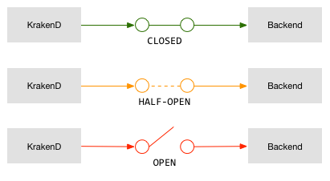
Circuit Breaker
In a distributed environment, calls to remote resources and services can fail due to transient faults, such as slow network connections, timeouts, or the resources being overcommitted or temporarily unavailable. These faults typically correct themselves after a short period of time,
However, there can also be situations where faults are due to unanticipated events, and that might take much longer to fix.

Slide 62
Circuit Breaker
Issues & Considerations
The Circuit Breaker pattern typically involves three states: Closed, Open, and Half-Open. Managing these states correctly is crucial. The Closed state allows normal operation, the Open state immediately fails requests, and the Half-Open state allows a limited number of test requests to check if the issue has been resolved, managing the logic around this is critical.
The circuit breaker might not fully protect applications from operations that fail in external services configured with lengthy timeouts.
Setting appropriate thresholds for the number of failures and timeouts is essential. If the thresholds are too low, the circuit breaker might open too frequently, causing unnecessary failures. If they are too high, the system might not protect itself effectively from cascading failures.
Providing a manual override option can be beneficial in systems where the recovery time for a failing operation is extremely variable.

Slide 63
Circuit Breaker
When to use this pattern
When an application encounters persistent or non-transient errors, such as a service being down or a network failure, the Circuit Breaker pattern can prevent the application from continually trying to perform an operation that is likely to fail
The pattern provides stability while the system recovers from a failure and minimizes the impact on performance. It quickly rejects requests for operations that are likely to fail, rather than waiting for them to time out or never return
Distribute resources across geographic regions or zones.

Slide 64
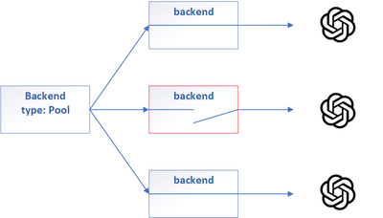

Circuit Breaker
Azure Solutions

Slide 65
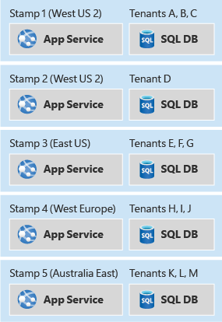
Deployment Stamps
The deployment stamp pattern involves provisioning, managing, and monitoring a heterogeneous group of resources to host and operate multiple workloads or tenants. Each individual copy is called a stamp, or sometimes a service unit, scale unit, or cell. In a multitenant environment, every stamp or scale unit can serve a predefined number of tenants.

Slide 66
Deployment Stamps
Issues & Considerations
It's crucial to have automated and fully repeatable deployment processes. Tools like Bicep, JSON ARM templates, or Terraform modules can be used to declaratively define your stamps and keep the definitions consistent
Routing each tenant's data and traffic should be directed to a specific region.
Deploying multiple copies of your infrastructure components will likely involve a substantial increase in the cost of operating your solution.
Different stamps might need to be on different versions of your solution at the same time. This requires careful management of updates and version control across stamps
Aggregating customer data, can become complex.

Slide 67
Deployment Stamps
When to use this pattern
If certain components of your system cannot or should not scale beyond a specific number of customers or requests, the Deployment Stamp pattern allows you to scale out by deploying multiple instances (stamps) of your solution
For applications that need to be deployed across multiple regions, each tenant's data and traffic can be directed to a specific region
When there is a requirement to separate certain tenants from others due to security concerns or compliance requirements.
If there is a need to have some tenants on different versions of your solution at the same time, the Deployment Stamp pattern allows for this flexibility by deploying different stamps with different versions

Slide 68
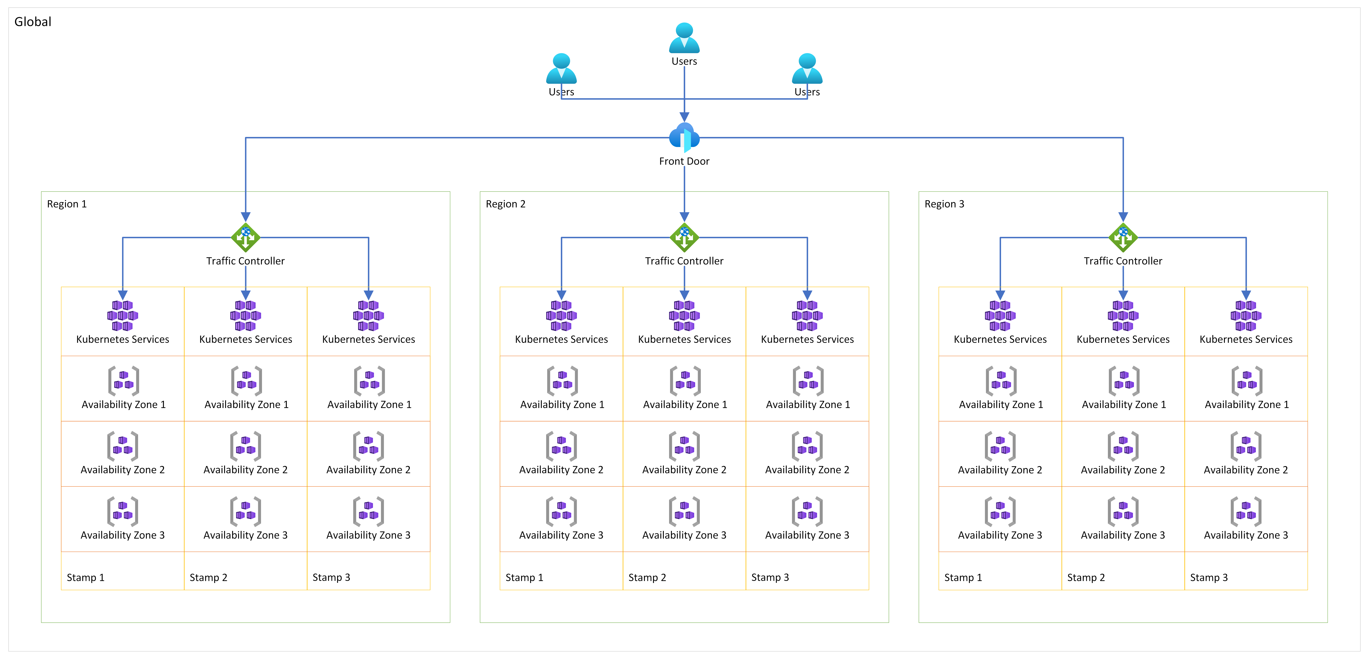

Deployment Stamps
Azure Solutions

Slide 69
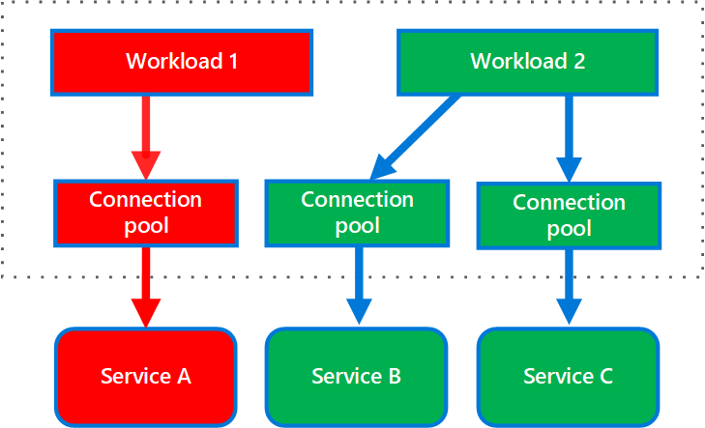
Bulkhead
The Bulkhead pattern is a type of application design that is tolerant of failure. In a bulkhead architecture, elements of an application are isolated into pools so that if one fails, the others will continue to function. It's named after the sectioned partitions (bulkheads) of a ship's hull. If the hull of a ship is compromised, only the damaged section fills with water, which prevents the ship from sinking.

Slide 70
Bulkhead
Issues & Considerations
If a service or consumer fails or becomes misconfigured, it can exhaust resources such as connection pools, memory, or CPU. This can prevent other services or consumers from functioning properly
Determine the appropriate level of granularity for bulkheads. For example, you could isolate resources at the service level, consumer level, or even at the tenant level
Implementing the Bulkhead pattern adds complexity to the system. It requires careful planning and management of resource allocation and isolation
Services and consumers should be partitioned into different groups based on load and availability requirement
Consider Security segmentation concerns between the components

Slide 71
Bulkhead
When to use this pattern
If you need to isolate resources used to consume a set of backend services. This is especially important if the application can provide some level of functionality even when one of the services is not responding
When you are worried about when a service or consumer fails or becomes misconfigured, it can exhaust resources such as connection pools, memory, or CPU.
Deploy services that offer a different quality of service for consuming applications. For example, a high-priority consumer pool can be configured to use high-priority services

Slide 72
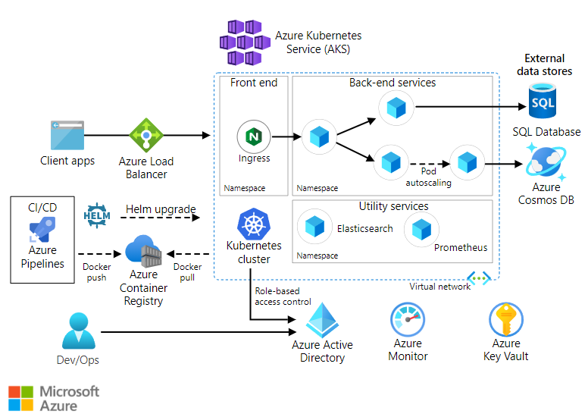
Bulkhead
Azure Solutions

Slide 73
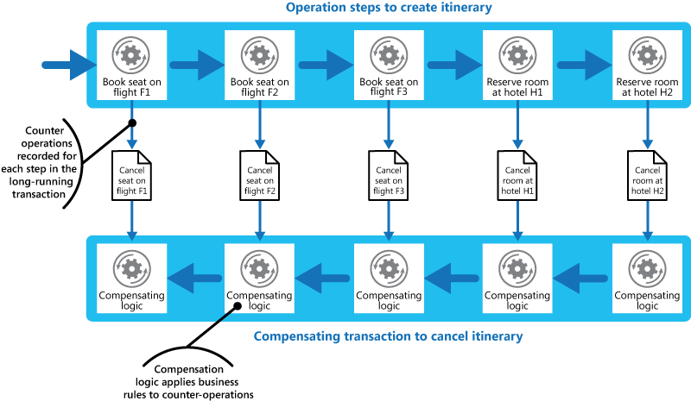
Compensating Transaction
When you use an eventually consistent operation that consists of a series of steps, the Compensating Transaction pattern can be useful. Specifically, if one or more of the steps fail, you can use the Compensating Transaction pattern to undo the work that the steps performed. Typically, you find operations that follow the eventual consistency model in cloud-hosted applications that implement complex business processes and workflows.

Slide 74
Compensating Transaction
Issues & Considerations
The order of the steps in the compensating transaction isn't necessarily the exact opposite of the steps in the original operation.
It might not be easy to determine when a step in an operation that implements eventual consistency fails. A step might not fail immediately but could get blocked. Implementing a time-out mechanism can help identify such failures
Compensation logic is often application-specific and relies on the application having sufficient information to undo the effects of each step in a failed operation. Generalizing this logic can be challenging
The infrastructure handling the steps must be resilient both in the original operation and in the compensating transaction. It should not lose the information required to compensate for a failing step and must reliably monitor the progress of the compensation logic

Slide 75
Compensating Transaction
When to use this pattern
Use this pattern to undo operations that implement the eventual consistency model. This is particularly useful when you need to maintain data consistency across distributed systems
When dealing with long-running transactions that involve multiple steps, the Compensating Transaction pattern can be used to undo the effects of each step if the transaction fails at any point.
In cases where manual intervention might be required to recover from a failed step.

Slide 76
Compensating Transaction
Azure Solutions

Slide 77
Security
Backends for Frontends
Create separate backend services to be consumed by specific frontend applications or interfaces.
Gatekeeper
Protect applications and services by using a dedicated host instance to broker requests between clients and the application or service.
Federated Identity
Delegate authentication to an external identity provider. This can simplify development, minimize the requirement for user administration, and improve the user experience of the application.
Gateway Offloading
Offload shared or specialized service functionality to a gateway proxy.

Slide 78
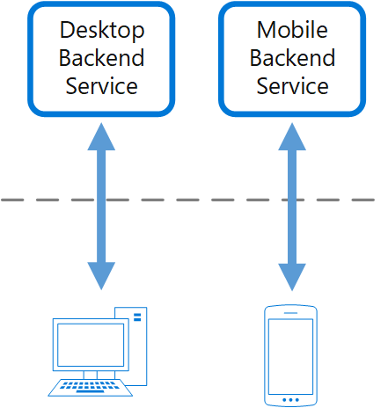
Backends for Frontends
Create separate backend services to be consumed by specific frontend applications or interfaces. This pattern is useful when you want to avoid customizing a single backend for multiple interfaces.

Slide 79
Backends for Frontends
Issues & Considerations
The BFF pattern reduces the attack surface by limiting the functionality exposed by each backend to only what is necessary for its corresponding frontend.
Different frontends (e.g., desktop web UI and mobile applications) have varying requirements in terms of screen size, performance, and display limitations. These differences can lead to competing requirements for the backend, making it challenging to serve both interfaces effectively
The backend can become a bottleneck in the development process due to the need to accommodate conflicting update requirements from different frontend teams.
The BFF pattern introduces segmentation and isolation by creating separate backend services for each frontend. This reduces the surface area of the API and limits lateral movement among different backends, which might expose different capabilities

Slide 80
Backends for Frontends
When to use this pattern
When different types of clients, such as mobile applications and desktop web browsers, require different payload sizes or interaction patterns, the BFF pattern is useful. It allows you to create separate backends for each client, which expose an optimal interface for that client
If the backend service becomes a bottleneck due to conflicting update requirements from different frontend teams, the BFF pattern can help.
When you need to tailor security and authorization mechanisms for each frontend

Slide 81
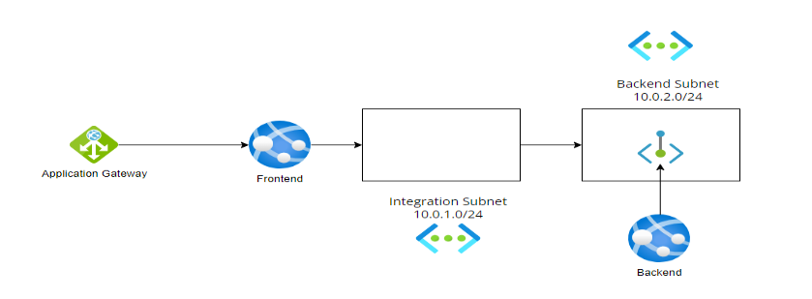
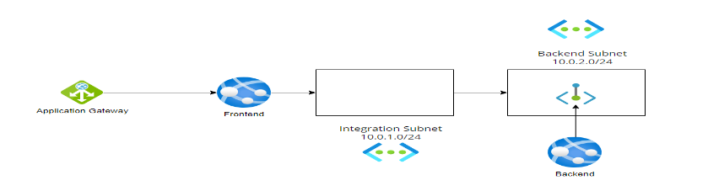
Backends for Frontends

Slide 82
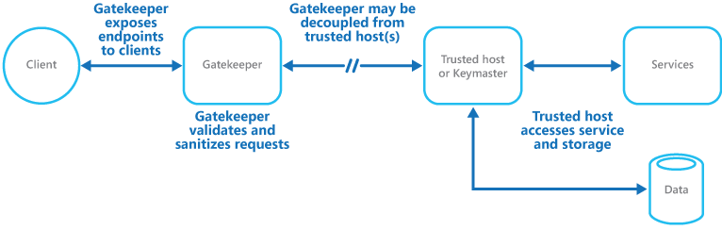
Gatekeeper
Protect applications and services by using a dedicated host instance to broker requests between clients and the application or service. The broker validates and sanitizes the requests and can provide an additional layer of security and limit the system's attack surface.

Slide 83
Gatekeeper
Issues & Considerations
The gatekeeper should not have access to the credentials or keys used by the trusted host to access storage and services.
The gatekeeper instance could become a single point of failure. If the gatekeeper fails, it can disrupt the entire system. To mitigate this, consider deploying redundant instances and using an autoscaling mechanism to ensure capacity and maintain availability
Adding the gatekeeper layer introduces additional processing and network communication, which can impact the overall performance of the system.
Implementing the gatekeeper pattern adds complexity to the system architecture. It requires careful design to ensure that the gatekeeper effectively validates and sanitizes requests without becoming a bottleneck or introducing new vulnerabilities

Slide 84
Gatekeeper
When to use this pattern
When your application handles sensitive information that requires a high degree of protection from malicious attacks, the Gatekeeper pattern is beneficial. It acts as an intermediary that validates and sanitizes requests before they reach the trusted host, thereby protecting sensitive data
For applications that perform mission-critical operations that cannot be disrupted.
When there is a need to perform request validation separately from the main tasks or to centralize this validation to simplify maintenance and administration, the Gatekeeper pattern is appropriate. It ensures that the core validation is done by the gatekeeper, while the trusted hosts might perform additional validation

Slide 85
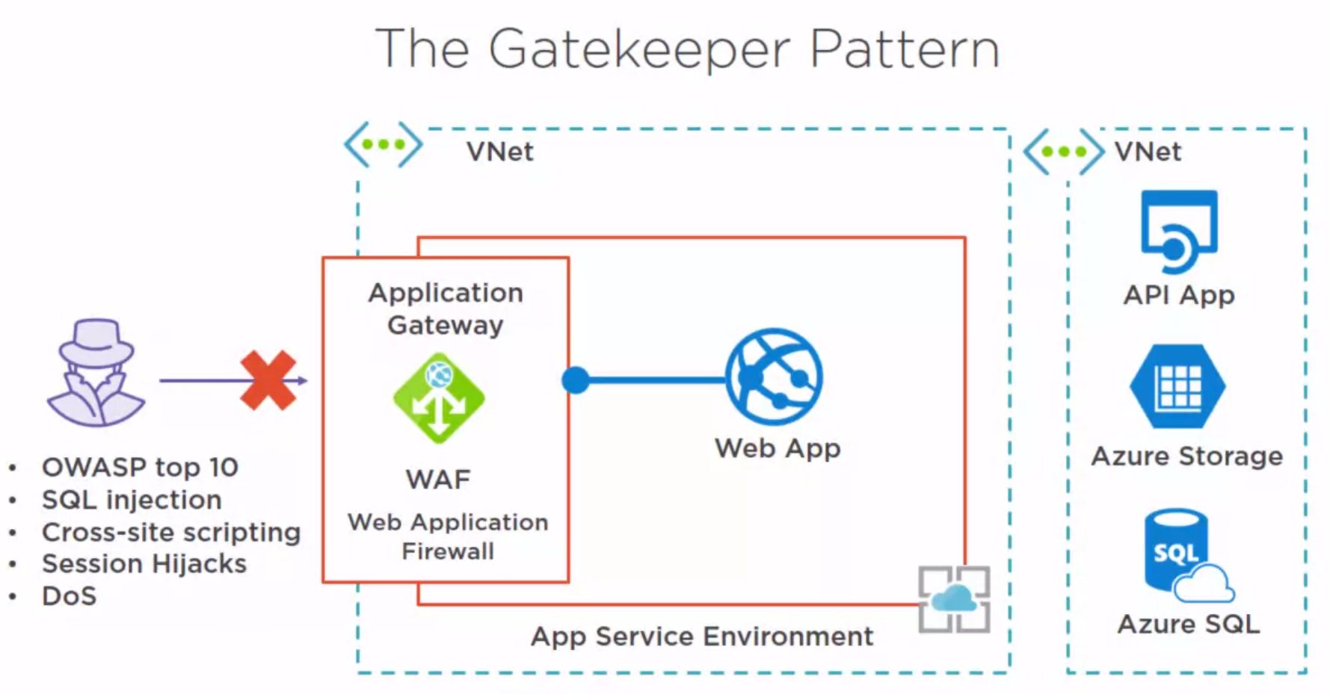

Gatekeeper

Slide 86
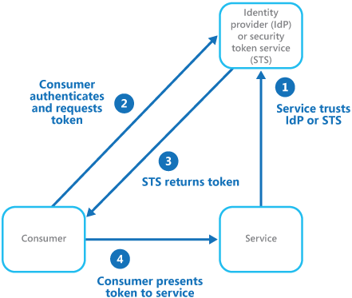
Federated Identity
Delegate authentication to an external identity provider. This can simplify development, minimize the requirement for user administration, and improve the user experience of the application.

Slide 87
Federated Identity
Issues & Considerations
Authentication can become a single point of failure. If the identity provider (IdP) or the Security Token Service (STS) fails, it can disrupt access to all applications relying on it. To mitigate this, consider deploying (or consuming a) identity management mechanism across multiple datacenters to maintain reliability and availability
The additional steps involved in federated authentication, such as token issuance and validation, can introduce latency.
t requires careful management of the relationship with the identity provider. This includes ensuring that the identity provider's security practices are robust, and that the integration is maintained
Implementing federated identity can be complex, especially if retrofitting it into existing applications that were built using different authentication mechanisms. This complexity can make it less cost-effective and more challenging to manage a bring your own solution.

Slide 88
Federated Identity
When to use this pattern
When you need to authenticate employees for corporate applications hosted in the cloud outside the corporate security boundary, without requiring them to sign in every time they visit an application.
Independent software vendors providing a ready-to-use service for multiple clients or tenants.
When you want to minimize the administrative overhead of managing user credentials within the application.
When you need to authenticate both corporate employees and business partners who do not have accounts in the corporate directory (B2B).

Slide 89
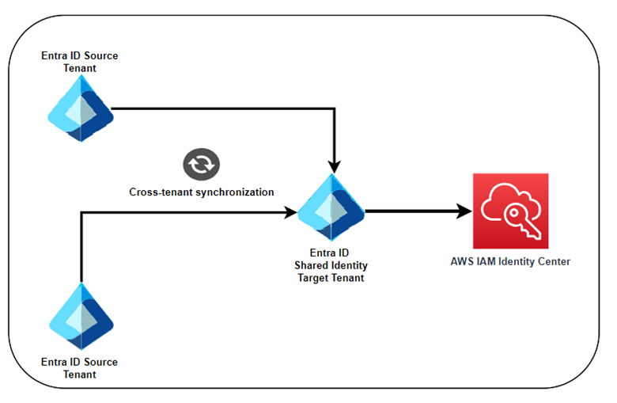
Federated Identity

Slide 90
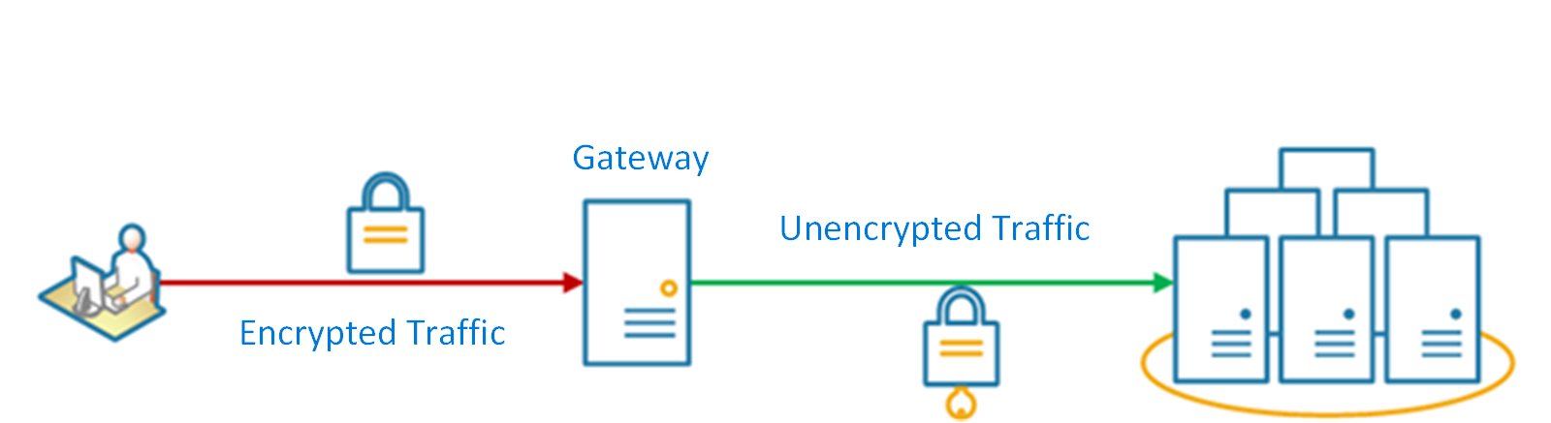
Gateway Offloading
Offload shared or specialized service functionality to a gateway proxy. This pattern can simplify application development by moving shared service functionality, such as the use of SSL certificates, from other parts of the application into the gateway.
Some features are commonly used across multiple services, and these features require configuration, management, and maintenance.
Offload some features into a gateway, particularly cross-cutting concerns such as certificate management, authentication, SSL termination, monitoring, protocol translation, or throttling.

Slide 91
Gateway Offloading
Issues & Considerations
Introducing a gateway can create coupling across services, which might not be suitable for all architectures. This coupling can lead to dependencies that complicate the deployment and scaling of individual services
The gateway itself can become a single point of failure if not properly managed. It is crucial to ensure that the gateway is highly available and resilient to failure by running multiple instances and designing it for the capacity and scaling requirements of the application
Offloading functionality to a gateway can introduce performance overhead. The gateway must be designed to handle the additional load without becoming a bottleneck for the application
Properly handling security issues such as token validation, encryption, and SSL certificate management requires specialized skills.

Slide 92
Gateway Offloading
When to use this pattern
When you need to offload shared or specialized service functionality, such as SSL certificate management, authentication, authorization, logging, monitoring, or throttling, to a gateway proxy. This can simplify application development by moving these cross-cutting concerns from other parts of the application into the gateway
When managing shared features across multiple services increases administrative overhead and the likelihood of deployment errors
Ensure consistency in request and response logging and monitoring across services.
When you want to allow dedicated teams to implement features that require specialized expertise, such as security.

Slide 93
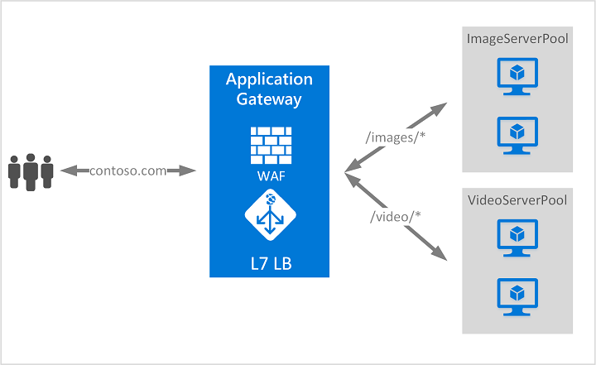

Gateway Offloading

Slide 94
Architecting for Azure

Slide 95
Architecting for Azure
1
2
3
Cloud Adoption Framework
Azure Architecture Center
Well-Architected Framework
Proven guidance and best practices that help you confidently adopt the cloud and achieve business outcomes.
Guidance for architecting solutions on Azure using established patterns and practices
A set of quality-driven tenets, architectural decision points, and review tools intended to help solution architects build a technical foundation for their workloads.
https://learn.microsoft.com/azure/cloud-adoption-framework/
https://learn.microsoft.com/azure/architecture/
https://learn.microsoft.com/azure/well-architected/

Slide 96
Recap of the modern design patterns
Design patterns
Architecture
DESIGN PATTERNS
Pattern categories
Implementation options for Azure

Slide 97


Slide 98
The time is now, go build!

Slide 99
Importance in modern cloud architecture
Group 4
Group 1
Group 2

